Slide 1

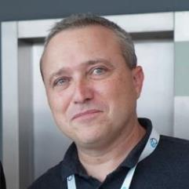

Beyond Operational Planning: Advocating the Strategic Value of an InnerSource Program Office (ISPO)
May 31st 2023
Thomas Froment
Co-Founder CTO

Slide 2
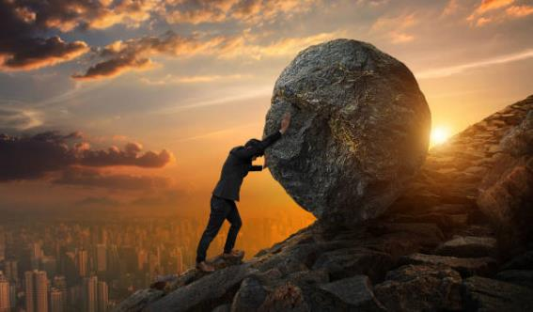

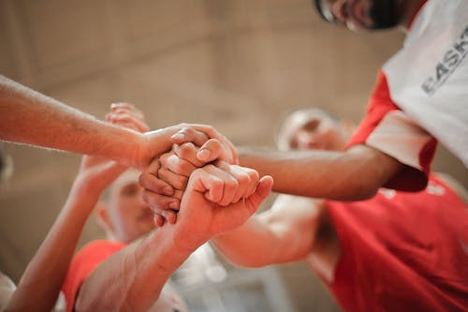
WHY ?

Slide 3


GREAT GOAL
An ecosystem of + 50 companies, schools and foundations, involving 1000 contributors to the Massive Cooperation Framework by 2030

Slide 4

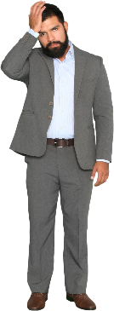





MCF from the field Value?
Members
Company (Institution)
Come join my community, it's really awesome!
Mike
Karl
But my members don’t have time!
But managers don’t get all the potential!
Jenny
ISPO Lead

Slide 5
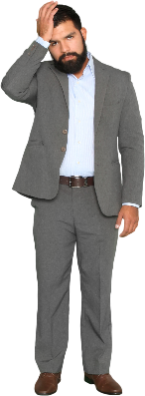

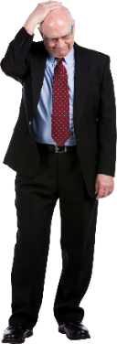




MCF from the field Which VALUE?
Members
Company (Institution)
Institutional commitment
Working time
Institutional resources (premises, tools, materials, budgets, etc.)
Skills and network
Personal commitment
Personal time
Personal resources
Skills and network
ISPO
1
2
Mike
Karl
Jenny

Slide 6
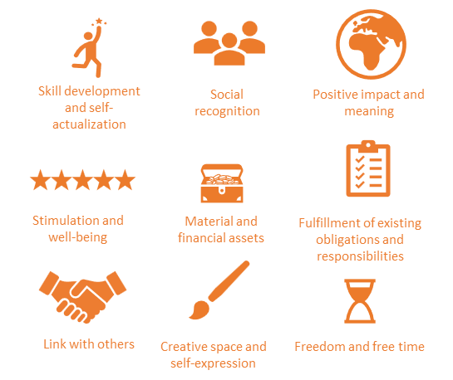
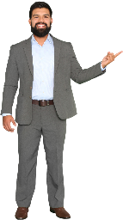




MCF from the field ISPO are collective forms of exchange
Members
Company (Institution)
Institutional commitment
Working time
Institutional resources (premises, tools, materials, budgets, etc.)
Skills and network
Personal commitment
Personal time
Personal resources
Skills and network
ISPO
1
2
Value for members
3
4
Value for the company
Human resources improvements
Operational improvements and serving the company's purpose
Business improvements

Slide 7
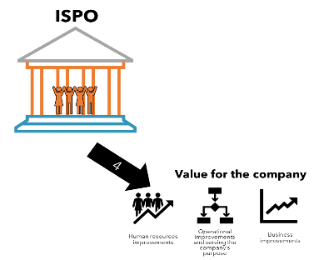

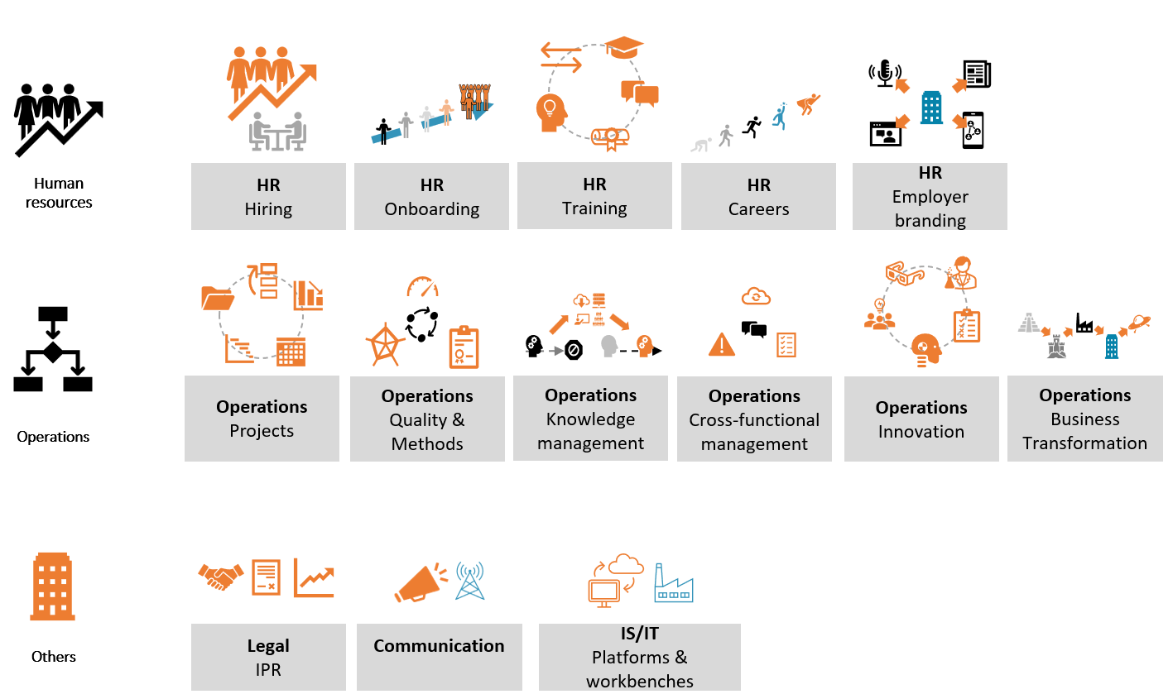
MCF from the field BUSINESS FUNCTIONS OFTEN IMPACTED

Slide 8
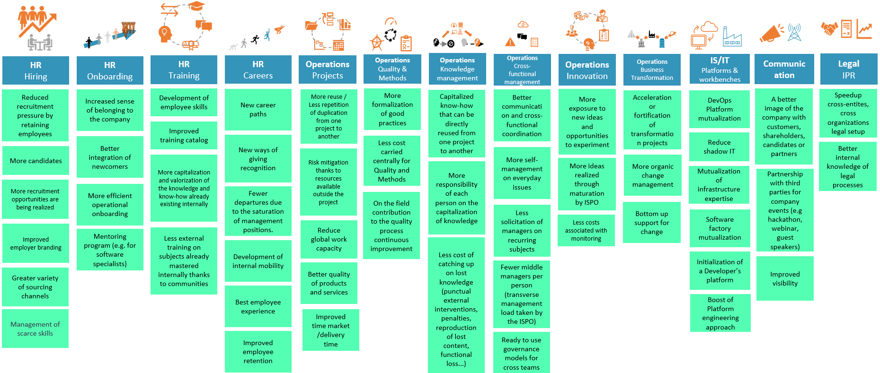
MCF from the field –STEP 1 IMPACT BY BUSINESS FUNCTION WORKSHOP VALUE

Slide 9
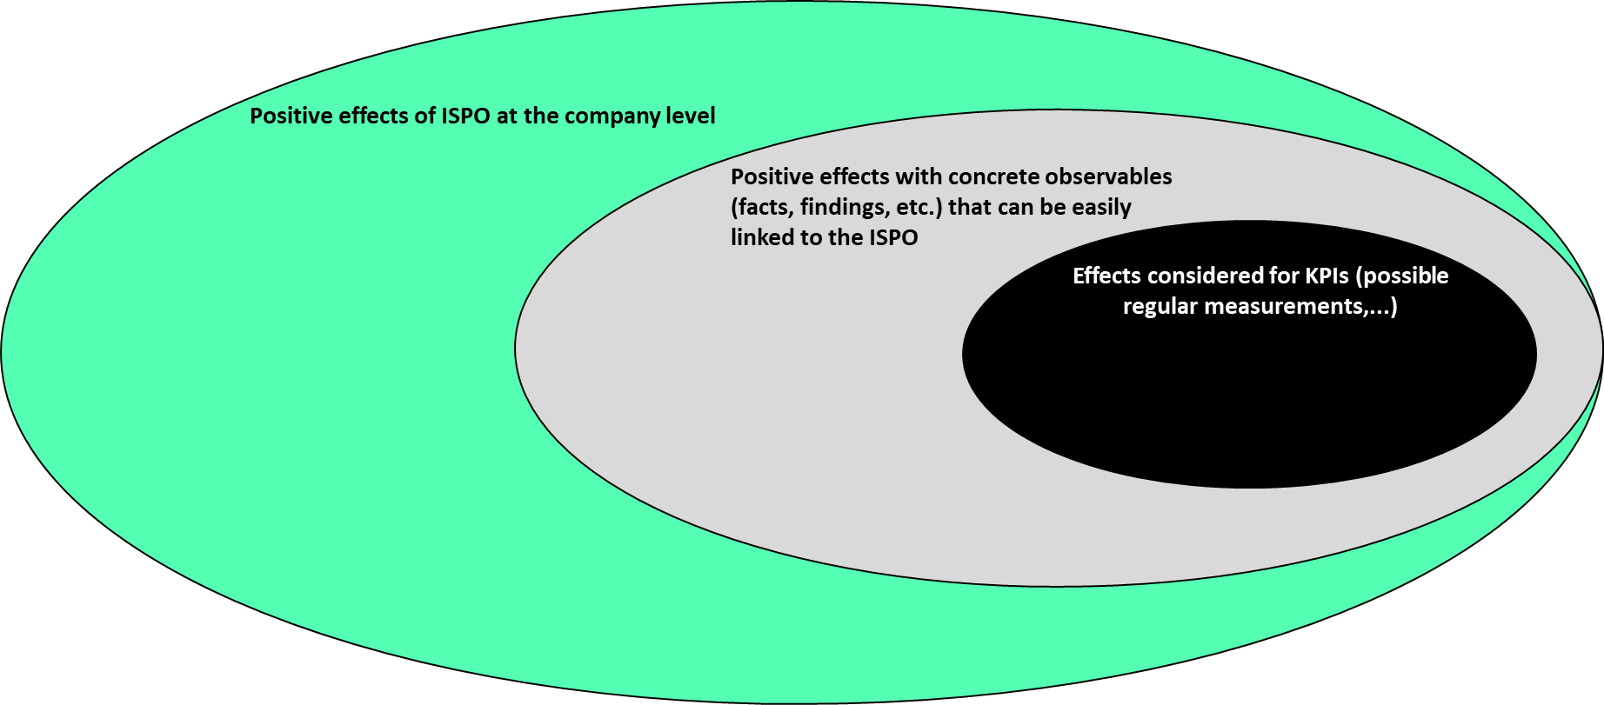
MCF from the field MEASUREMENT PRECISION

Slide 10
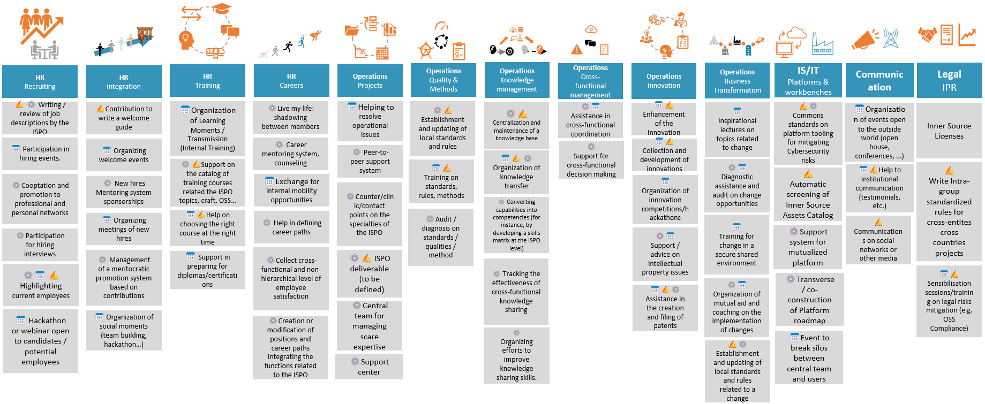
MCF from the field – STEP 2 ACTIVITIES by services to business functions
📅Events , ✍️Contents, ⚙️ISPO Structuration

Slide 11









MCF from the field SPONSORS are ISPO BROKERS
Sponsor
Members
Company (Institution)
Lisa
ISPO
1
2
3
4

Slide 12
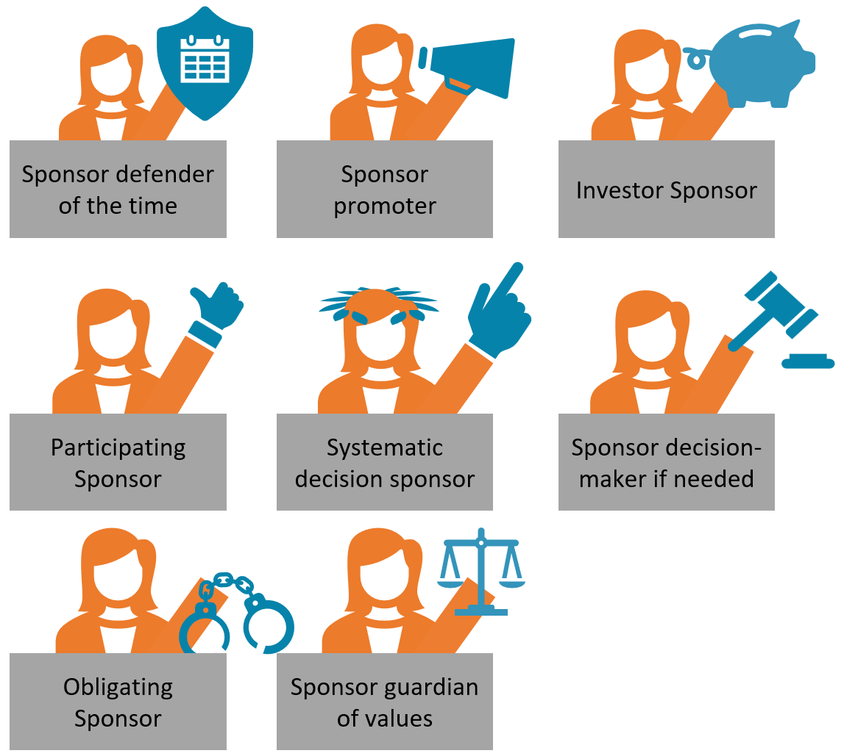
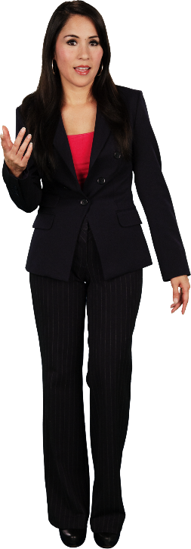
MCF from the field Giving SPONSORS a ROLE
Lisa

Slide 13
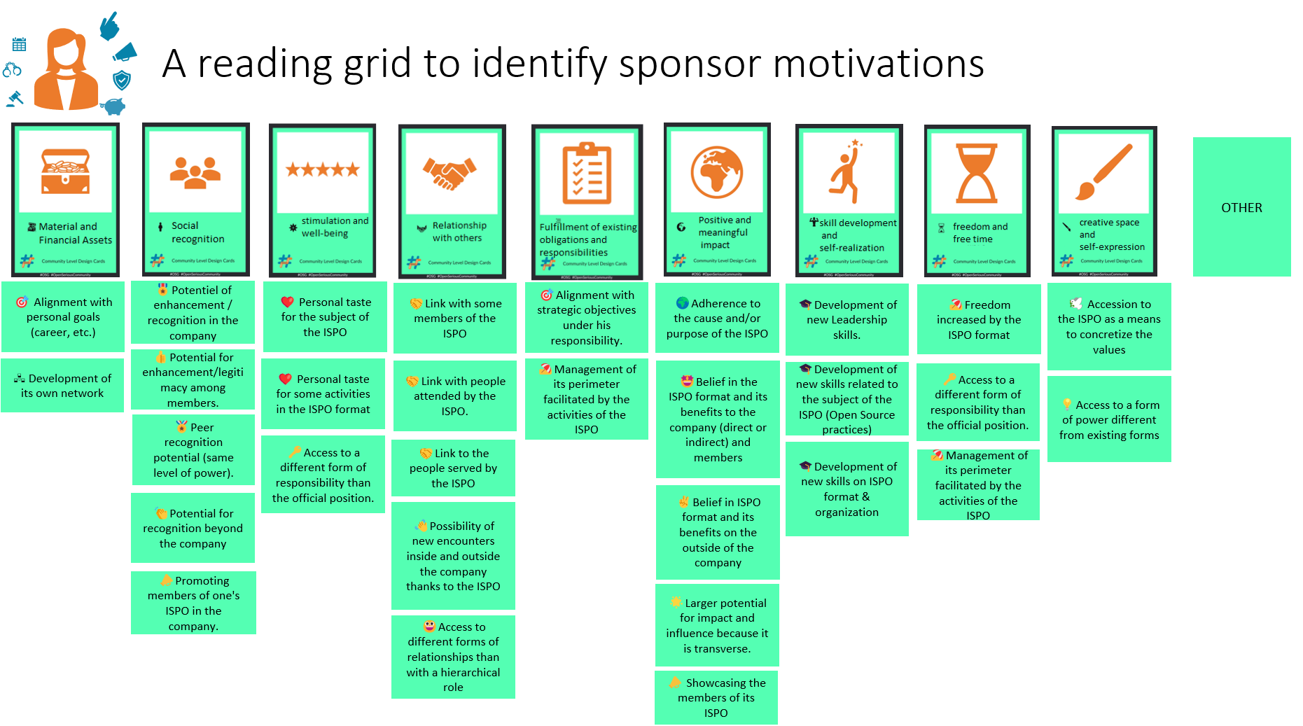

MCF from the field –EXAMPLE FIND the VALUE FOR SPONSOR
Lisa

Slide 14
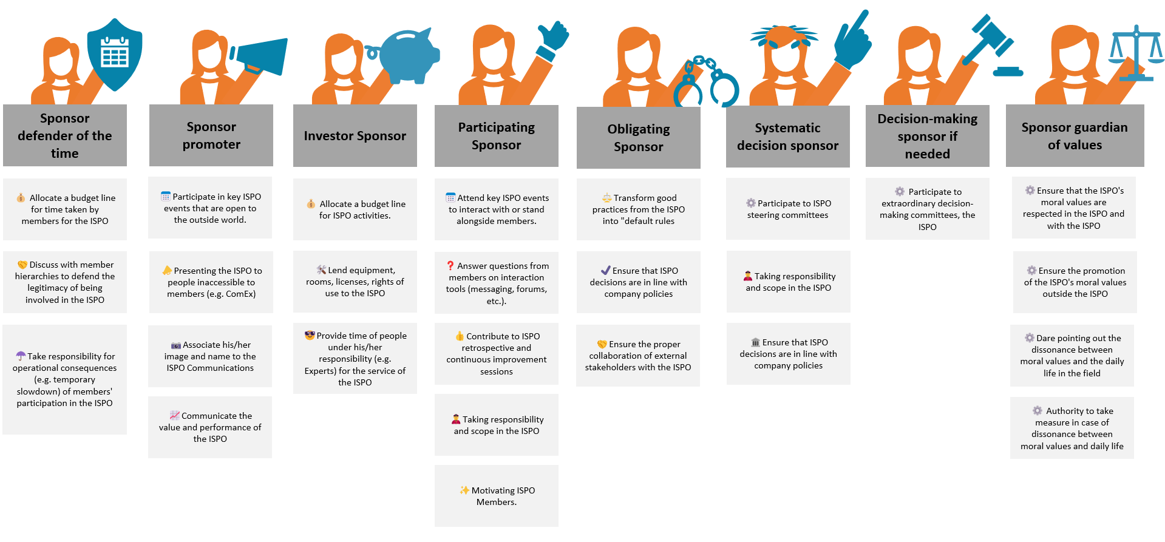
MCF from the field –EXAMPLE OPERATIONAL ACTIONS FOR SPONSOR
Lisa

Slide 15
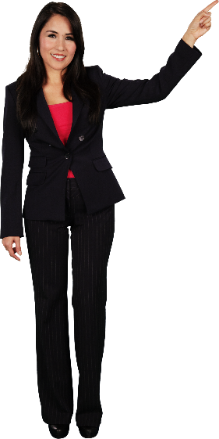
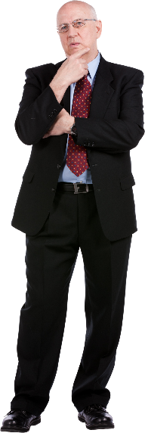
MCF from the field ISPO $$$ 3 key actors
Jenny
Lisa
Karl
ISPO Lead
Sponsor
Decision maker

Slide 16


MCF from the field ISPO $$$
That's great, we gather +700 people at every community event.
$+$+$...
That's great, we have 837 commits from +120 people
Jenny
I allocate 10% of time for my team to contribute to InnerSource
Karl
Lisa

Slide 17
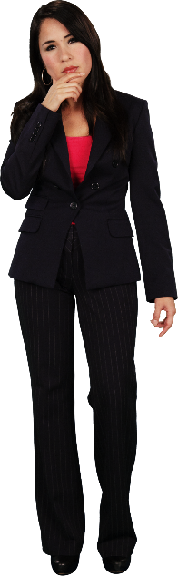


MCF from the field ISPO $$$ Language translation 1/2
Community language
Language of business functions and activities
Great
Community activities
Number of hours spent
Community cost
"Classic" work (delivery) which is not otherwise carried out (opportunity cost, in the form of the risk of late penalties, etc.).
Similar effects on non-members (solicitations, delays, etc.)
Great
Community activities
Jenny
Great
Community activities
Lisa

Slide 18



MCF from the field ISPO $$$ Language translation 2/2
Language of business functions and activities
Loss in sales, or increase in costs, or increase in risk on sales, or increase in risk in costs
Hourly rate
$
Number of hours spent
+ Community expenditure
+ "Classic" work (delivery) that is not otherwise carried out (opportunity cost, in the form of the risk of late penalties, etc.).
Similar effects on non-members (solicitations, delays, etc.)
$
Language of Money
$
Lisa
Karl
$

Slide 19



MCF from the field ISPO $$$ Language translation summary
Community language
Language of business functions and activities
Language of Money
Specific to each company and context
Company Value Grid #MCF
Jenny
Lisa
Karl
Gain in sales, or cost reduction, or risk reduction in sales, or risk reduction in costs
Effects within the company (e.g:
Increase in retention)

Slide 20
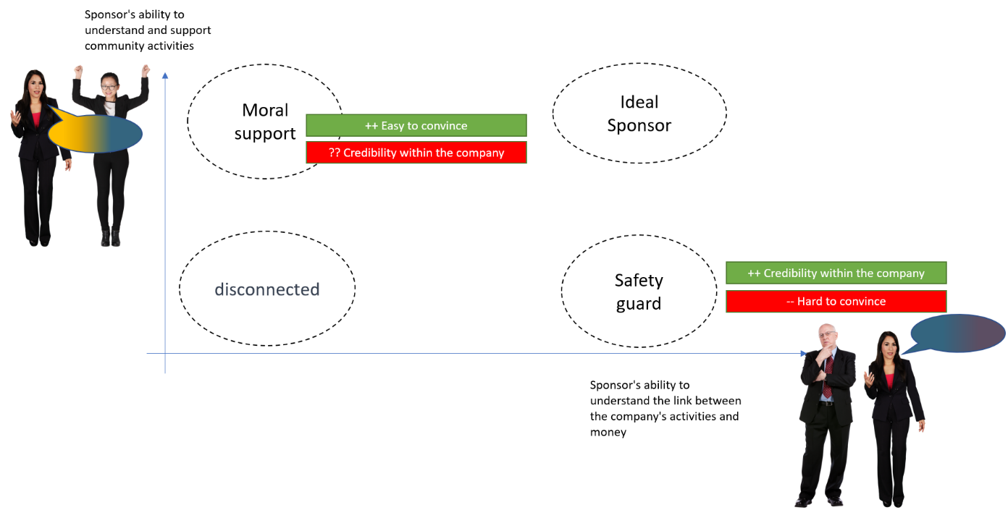
MCF from the field Sponsor's level of language proficiency

Slide 21
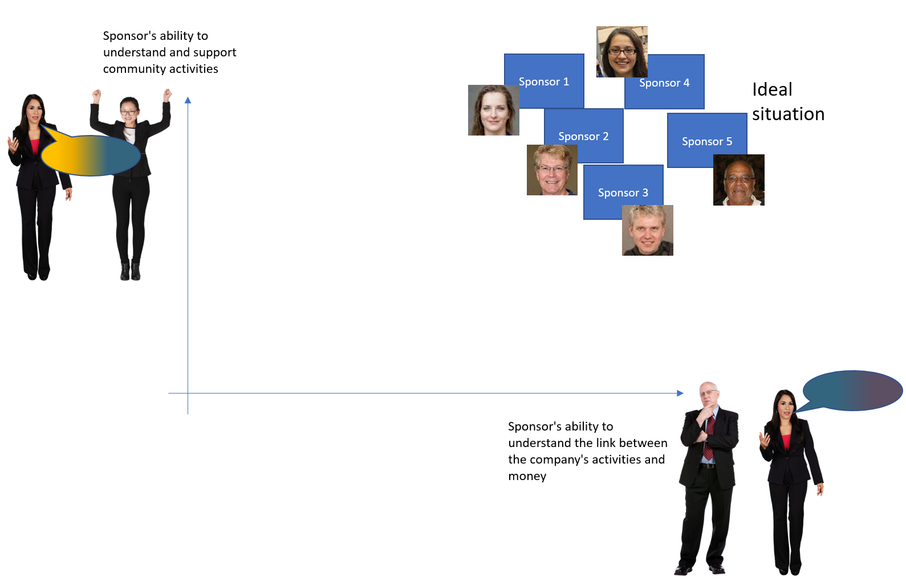
MCF from the field Sponsor's level of language proficiency Case 1/4

Slide 22
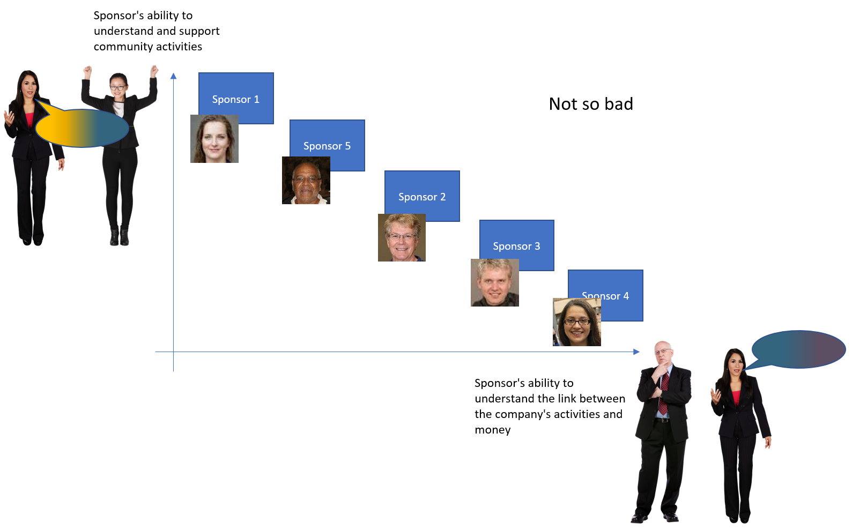
MCF from the field Sponsor's level of language proficiency Case 2/4

Slide 23
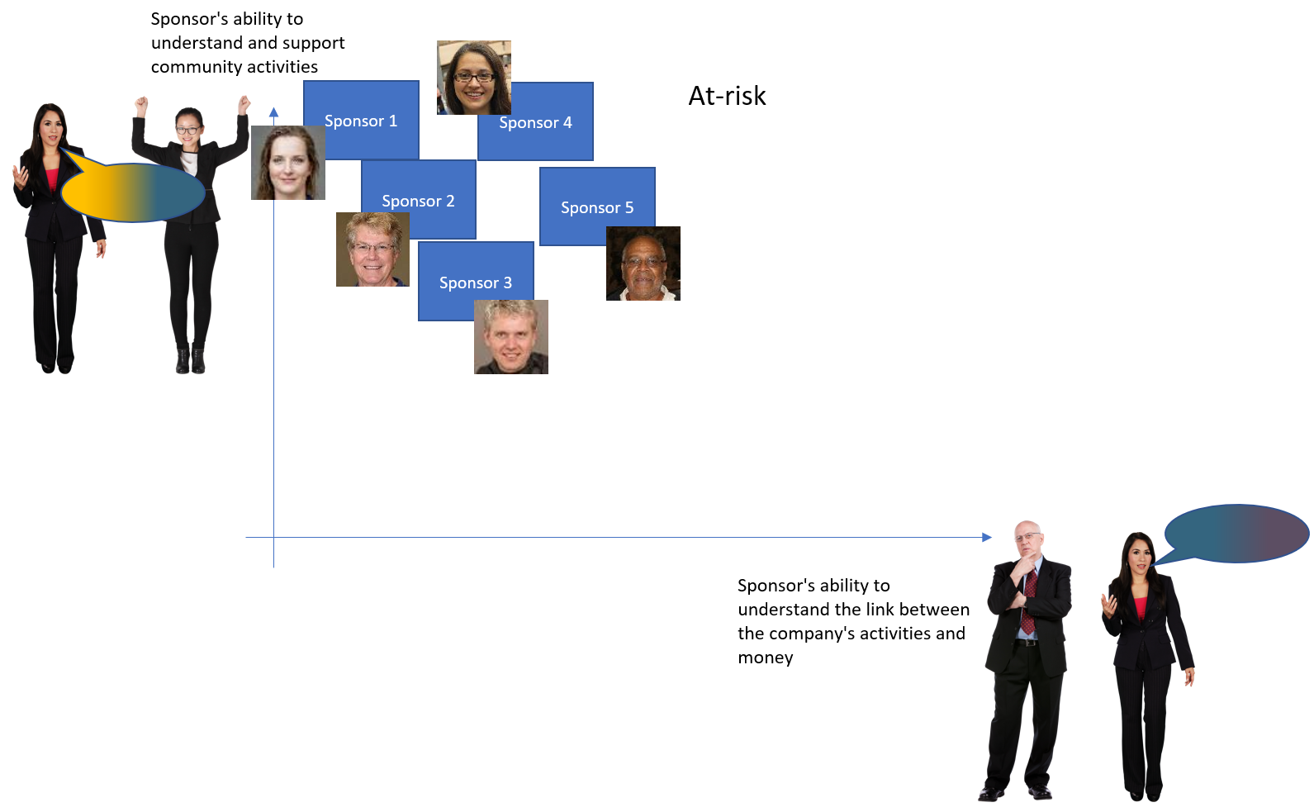
MCF from the field Sponsor's level of language proficiency Case 3/4

Slide 24
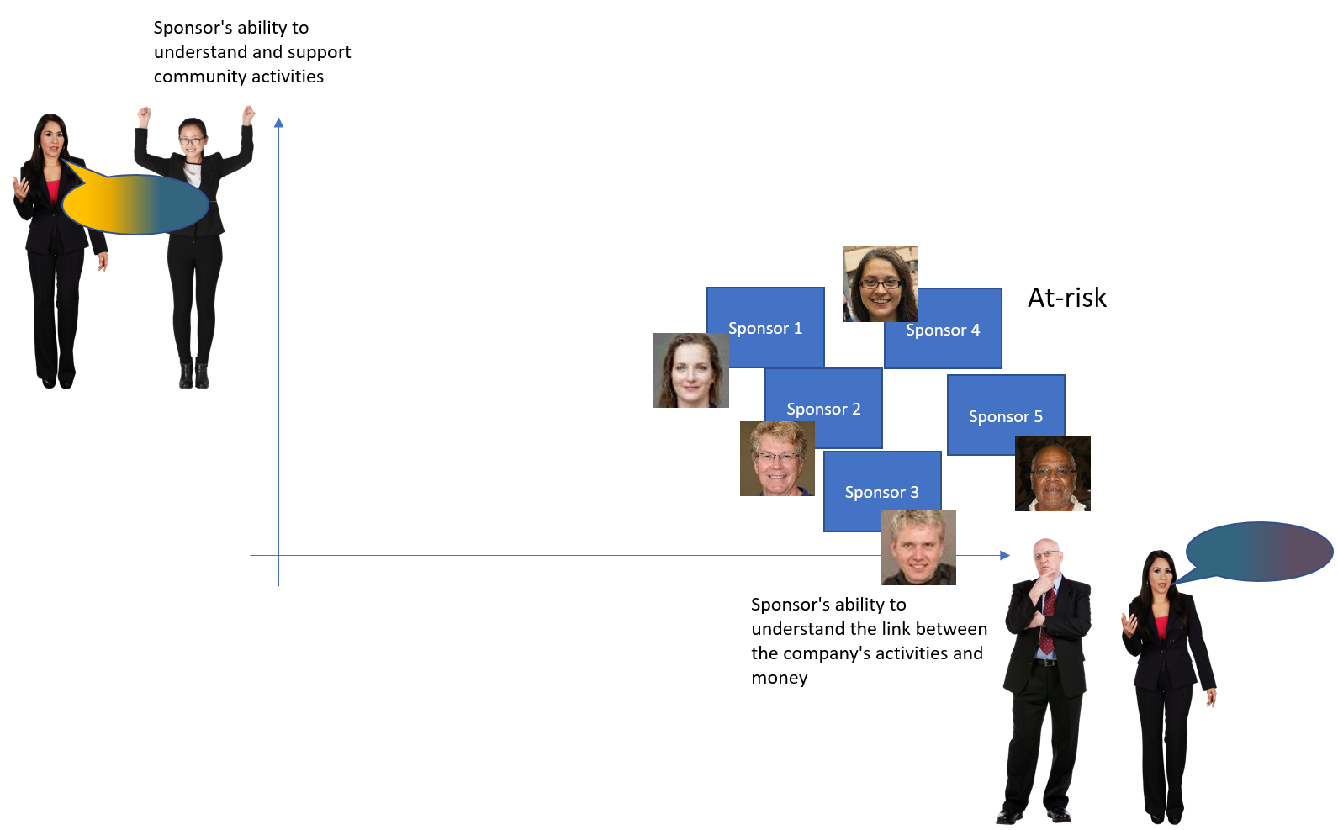
MCF from the field Sponsor's level of language proficiency Case 4/4

Slide 25
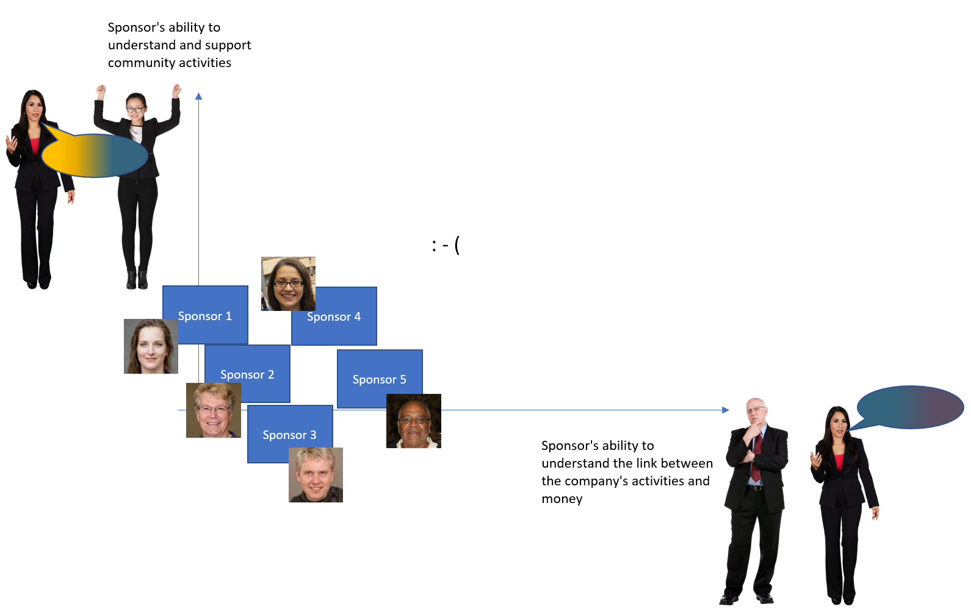
MCF from the field Sponsor's level of language proficiency WORST CASE

Slide 26
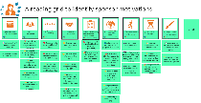


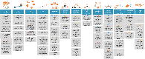
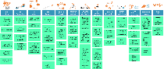





MCF from the field Advocating the Strategic Value of an ISPO STEP 1/5
Work on the Value from all perspectives
Requested Value
Provided Value
Members
Sponsors
Company

Slide 27









MCF from the field Advocating the Strategic Value of an ISPO STEP 2/5
Find impacted functions of your company

Slide 28
MCF from the field Advocating the Strategic Value of an ISPO STEP 3/5
Find impacted functions of your company
Among them, find sponsors and assign them role

Slide 29
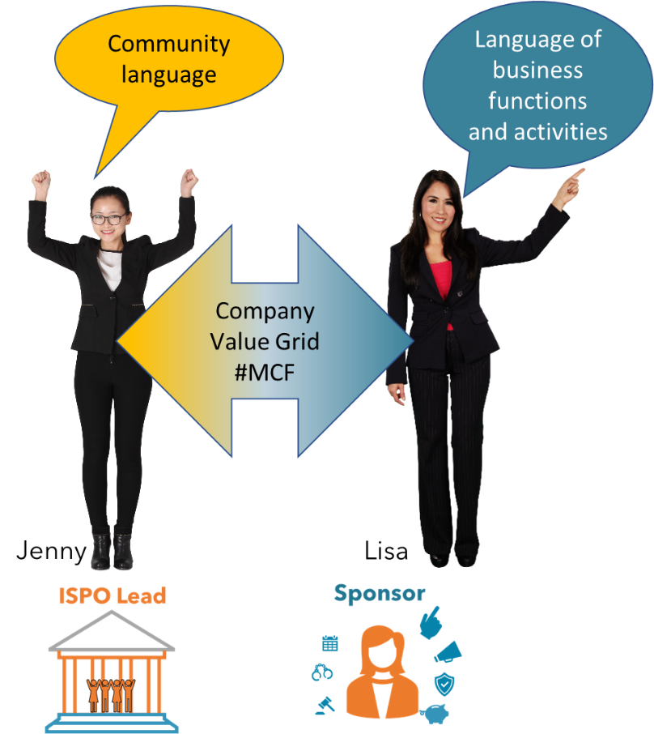
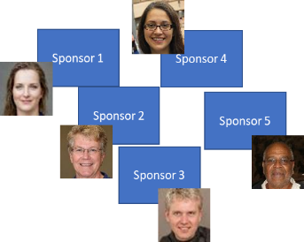
MCF from the field Advocating the Strategic Value of an ISPO STEP 4/5
Help translate the language of the community
into the Sponsor's language
Repeat with each
sponsors

Slide 30
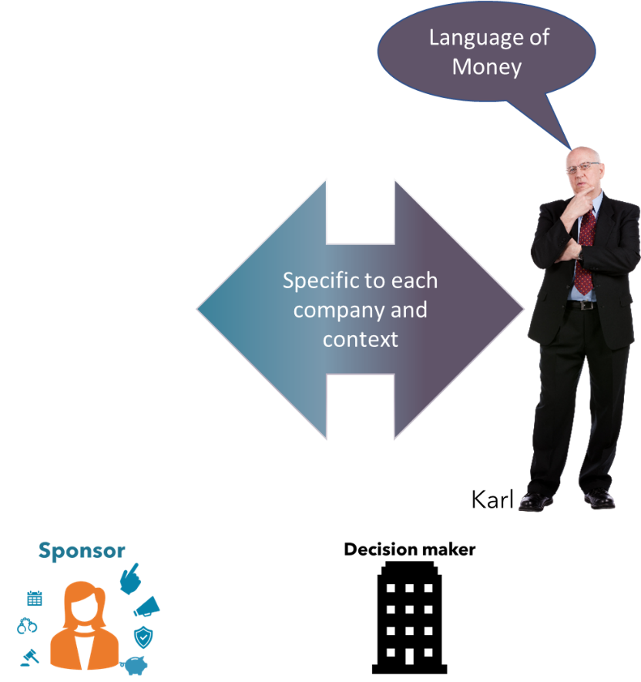
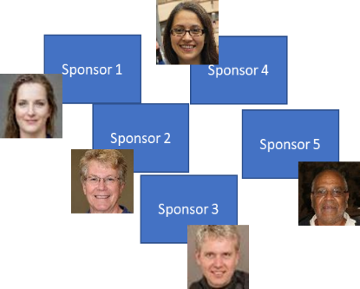
MCF from the field Advocating the Strategic Value of an ISPO STEP 5/5
Analyse you sponsors’ ability to be good translators

Slide 31
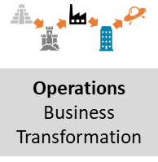

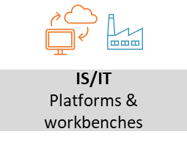

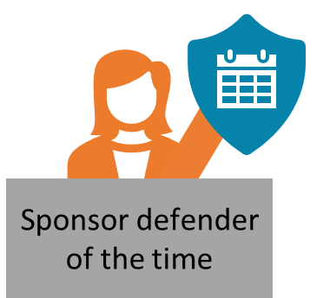
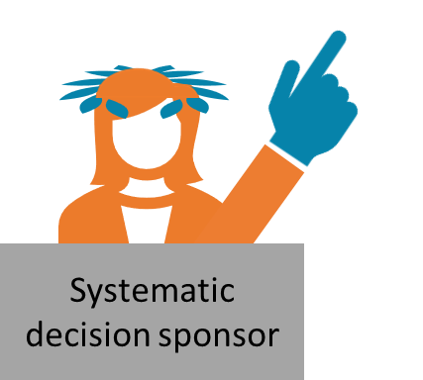


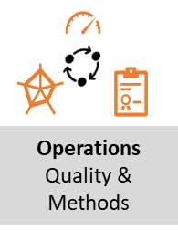


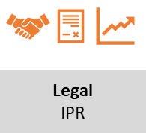

MCF from the field Advocating the Strategic Value of an ISPO finally
And try again…
Looking for a sponsor

Slide 32

In SHort

Slide 33


WHAT’s Next
https://github.com/InnerSourceCommons/ispo-working-group
Partial (and mainly FR) content of MCF (May 2023): https://openseriousgames.org/openseriouscommunity/
Coming soon – (Sept 2023)
Full Open Source (CC BY 4.0) contributive framework on Github

Slide 34

Questions

Slide 35
ANNEX 1 frictions between sponsors
Potential Sponsor
Potential Sponsor
Potential Sponsor
Potential Sponsor
Potential Sponsor
Potential Sponsor
Potential Sponsor
Potential Sponsor
Potential Sponsor

Slide 36

ANNEX 1 frictions between sponsors
Sponsor 1
Other people at the same level (not sponsors)
MEMBERS
MEMBERS
MEMBERS
MEMBERS
MEMBERS
MEMBERS
MEMBERS
MEMBERS
MEMBERS

